Slide 1
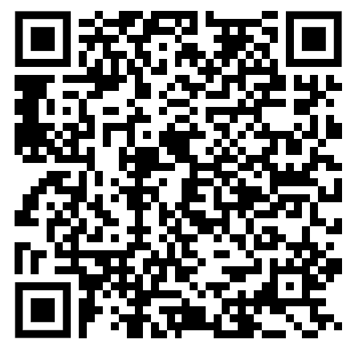
WICS:
Undergraduate Research

Slide 2
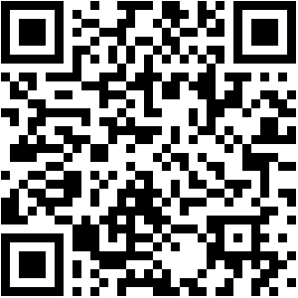
Before we begin… merch!!

Slide 3
Announcements
-Still time to register for SheInnovates!
-Resume/LinkedIn/Question drop is always open
-WiCS Github repo is now open

Slide 4
What is undergraduate research
“an inquiry or investigation conducted by an undergraduate student that makes an original intellectual or creative contribution to the discipline.”
work closely with one of Pitt’s expert faculty members on their project
Work with a PHD student
propose a project of your own.

Slide 5
Why do undergraduate research
01
03
04
02
05
apply knowledge from classes to a more specific question/discipline
Explore different fields/interests of CS
Flexible work hours/paid $$
enhances student resumes/portfolios
Make connections with faculty

Slide 6
Research Examples!!

Slide 7
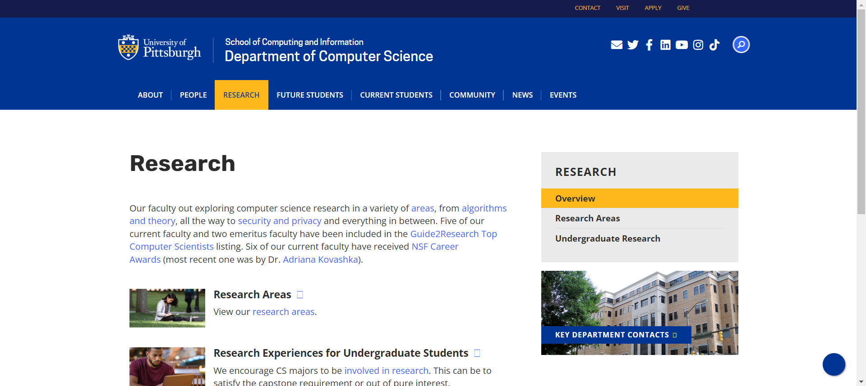
How to start
https://www.cs.pitt.edu/research

Slide 8
Writing an Email
Dear Dr./Mr./Ms.,
My name is ______ and I am a (grade) pursuing a degree in _____. In my (coursework/internship/ect.), I have developed a passion for ________. I did some research and learned about your lab and your recent project on ________ (whatever it is that interested you) caught my eye.
Mention profile (and their work)
Discuss specific project you are interested in (if applicable)
Ask for the opportunity to talk with them about their projects and undergraduate opportunities
Attach resume and any other information necessary

Slide 9
Tips
Make sure you are interested in the work
Reach out with confidence
Ask Questions
Set specific goals each week with your mentor
Find a healthy balance
Know the big picture

Slide 10
Email Example
Dear Dr. Hu,
I hope you are doing well. My name is Aditi Junagade, and I am a freshman majoring in neuroscience with minors in chemistry and computer science. I am interested in neurological disease research, both neurodegenerative diseases and therapies for such diseases. I was looking at the CNUP website and found the idea behind your ongoing research project on immunotherapies for ischemic brain injuries to be very engrossing. If possible, I would love to volunteer or work to support you on a long term research project you have been conducting, as well as have you as a mentor in research and in the career path of becoming a neurologist. If this is not possible or if you are not accepting any students, I would greatly appreciate it if you could please refer me to any other research teams or colleagues of yours that may be interested.
Since I have prior experience working in a toxicology lab processing urine samples and running drug tests on them, I am well informed about and acclimated to the fast-paced learning environment present in a laboratory. This, accompanied by my interest in the research you are performing, leads me to believe that I will thrive in your lab.
In terms of availability, I am available to start as soon as you would prefer me to, and am willing to dedicate about 8-10 hours per week for this position.
I would be glad to meet to discuss my potential position and answer any questions you may have. I have also attached my resume and a brief cover letter to this email for your convenience.
Thank you for taking the time to read this email and consider my request; I truly appreciate it.
I look forward to hearing from you soon!
Regards,
Aditi Junagade
Neuroscience Student
University of Pittsburgh, Class of 2025
anj118@pitt.edu
linkedin.com/in/aditi-junagade

Slide 11
A Day in CS Research!!
Usually mentored by a grad-student or post-doc
Occasional meetings with the professor
Working on a starter project
Reading academic papers
Designing/Implementing some code as part of a larger project
Proving a theorem
Derive runtime of an algorithm
Run tests on a system or program
Eventually will build up to leading your own project

Slide 12
Connections with scientific research
Always need someone to analyze data (someone who’s unbiased)
Lots of connections between health and tech - pharmaceuticals, AI, face detection, etc
Work in a dry lab and get a publication under your name
Neuro-immunological lab: immunological therapies for stroke
Lots of data analysis, computer visualization of cells based on recordings, software analysis of cell structures, statistical analysis (ANOVA, T-tests, etc)

Slide 13
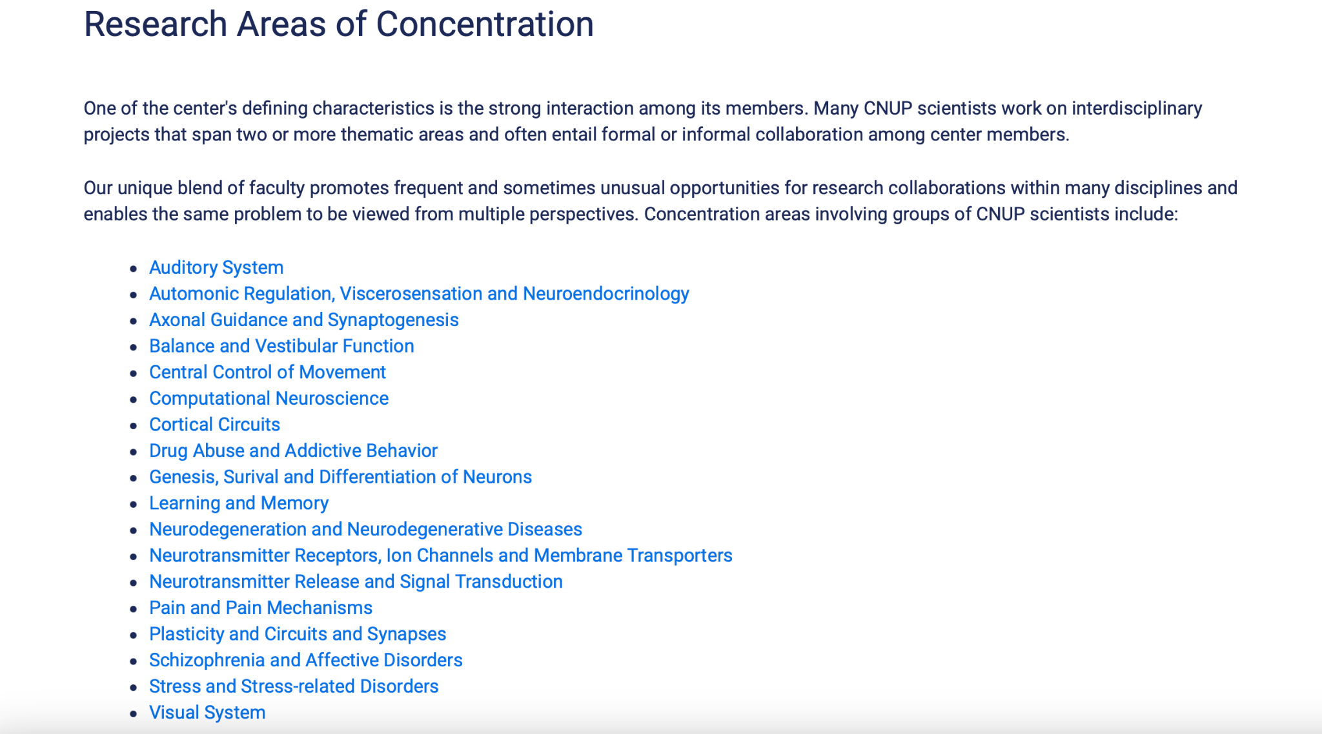
Where to look?
https://www.cnup.pitt.edu/research-areas-concentration

Slide 14

Now lets make a program to show how computation can be used!
Happy groundhogs day

